Slide 1
ConnectBud
Python
Class 7
By: Rahul Joshi

Slide 2
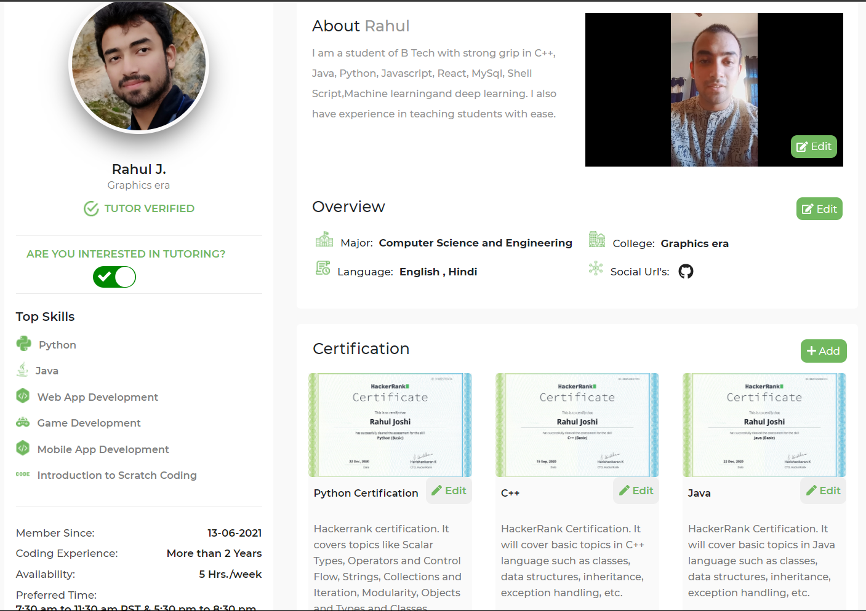

Slide 3
Class Overview
Class 7: • Loops

Slide 4
Class 6 H.W.
num1=int(float(input("num1=")))
num2=int(float(input("num2=")))
operator=input("operator = ")
if operator== "+":
print(num1+num2)
elif operator=="-":
print(num2-nun1)
elif operator== "*":
print(num1*num2)
elif operator=="/":
print(num1/num2)

Slide 5
Range function( )
range(10) => (0,10) => [0,1,2,3,4,5,6,7,8,9]
Range(5,10) => (5,10) =>[5,6,7,8,9]
Range (5,15,2) =>[5,7,9,11,13]

Slide 6
For loop
Syntax:
for (container) in (list):
(task)
Explaination:
take every value in the list ,
store that value in the container,
perform the task for every new value of a container.

Slide 7
Example
a=["arav",11,['a','r','a','v'],"hello"]
for c1 in a:
print(c1)
for c1 in range(10):
print(c1)

Slide 8
While loop
Syntax:
while (comparision):
task
1. Check if the comparision returns true.
2. If it returns true then perform the task.
3. If it returns false then stop the loop.

Slide 9
Example
c1=20
while c1>0:
print(c1)
c1-=2

Slide 10
Task
5 * 1 = 5
5 * 2 = 10
.
.
.
.
5 * 10 = 50
Print out all the multiples of 7 less than 231

Slide 11
End
For any queries: Contact:
Rahul Joshi rj26280218@gmail.com

